Slide 1
Friday May 13th 11:00 AM NASAP 2016 The Interpretive Interview With Families: Explaining the Family to the Family
Michael C. McDonough. LCP
Associate Fellow Irish Psychological Society
Notes:
I have been in private practice and worked within a multidisciplinary team for over 10 years. I can’t begin to tell you how important it is to work from a theoretical base.
In the last century, when I obtained my license it was necessary to pass written and oral examinations. For part of the oral exam I had to present a case from diagnostic interview through the development of a treatment plan to termination.
Back then for that exam if you used the word eclectic you did not get through.
By the time of my examination I had attended and even presented at NASAP conferences and those experiences proved invaluable when it came to presenting my theoretical base.
At some convention, I think it was an American Psychological Association convention in San Francisco I got a good phrase. It went something like “Culture is the water that the fish swims in”
What I found out about my basic and ever growing understanding of Individual Psychology was that it worked in Tidewater Virginia, Bermuda, rural Ireland and in the mountains of Southwest Virginia and Northeast Tennessee. Four very different ponds, let me tell you.

Slide 2
Overview
Who
What
When
How
Notes:
I think it is good to have a bit of a road map so here is ours for today.

Slide 3
Gate City Sign

Slide 4
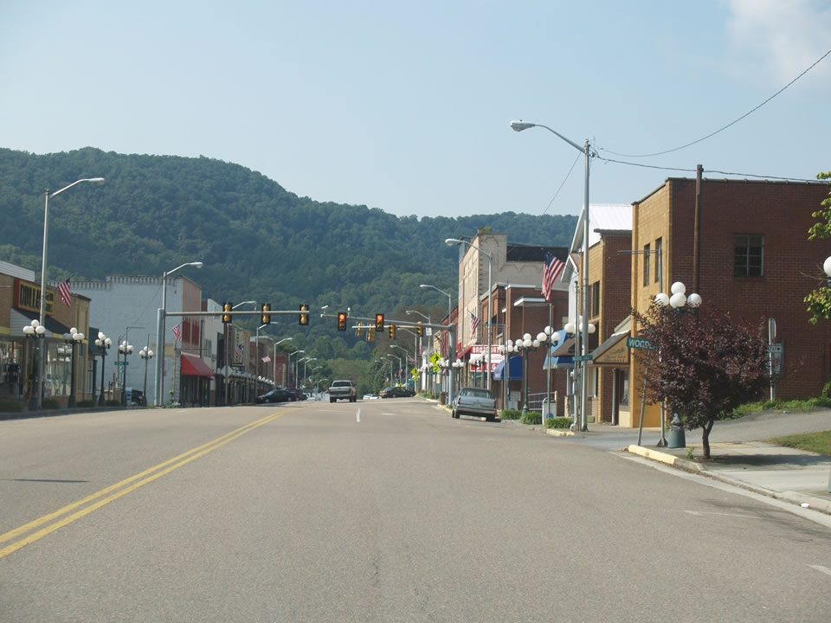
Gate City, VA Main Street

Slide 5
Who
Families from rural Southwest Virginia with children ages 0 to 21
Mostly non-traditional including single fathers/mothers, step/blended families, foster families, children being cared for by relatives including grandparents, great-grandparents, Aunts/uncles/cousins, etc.
Over 80% Medicaid
Notes:
This clinic serves 12 counties and 4 independent cities. At last count 315,000 individuals lived in this catchment area.

Slide 6
What Occurs
Initial Contact by our Office Service Specialist
A nursing history including vital signs
A social history by the LCSW
A psychological evaluation including: behavioral observations, assessment of reasoning and processing skills, memory, emotional functioning and visual-motor integration. Quantitative and qualitative information are included
Educational Assessment
Basic physical and medical history
Notes:
At this time our families are told there is 4 to 5 month waiting list. If they can arrange things we have what is called a “Short-Call List”

Slide 7
When
This covers an entire day due to the distances involved for these families. Many come the night before and stay at local motels.

Slide 8
How
The gist of this little talk
Initial referral
Telephone contact
Day of Assessment
Acknowledgment of referral information
Short term follow-up
Long-term follow-up
Data Base

Slide 9
Breakdown of an Adlerian Encounter
(1) Establish a Relationship
(2) Perform some Analysis and Assessment
(3) Provide some Moments of Insight
(4) Reorientation (establish some new patterns of interaction)
Notes:
Adlerian relationship building is an intregal part of this process

Slide 10
A Bit of Background
From June 2011 till present over 950 Families
A Team including Clinic Nurse, Educational Specialist, Licensed Clinical Social Worker, and a Family Nurse Practitioner, and an Office Service Specialist
A very underserved part of the world
If you can’t measure it you can’t manage it

Slide 11
Establish a Relationship
Before I go out to meet the family (smile)
Establish who I am (I share my card)
How might people be connected
How might people be addressed
What is my job
How will the task be accomplished

Slide 12
Perform some Analysis and Assessment
(1) Who speaks when the child is addressed
(2) Information from several sources
(3) Use reliable valid assessment measures
(4) Take good behavioral observations

Slide 13
Provide Some Moments of Insight
(1) A team approach
(2) A description of where the results are shared
(3) Speak in the language of the consumer (Basic Health Literacy)
(4) Make sure there is time for questions or elaborations

Slide 14
Reorientation Establishing new patterns pf Interaction
(1) Present the findings verbally
(2) Have a copy of the findings in written form
(3) Have a plan of action
(4) Explain how follow up will occur

Slide 15
Demonstration
Look for Adlerian Concepts such as:
Encouragement
Respect
A relationship among equals
Teleology

Slide 16
Comments & Questions

